Slide 1
生产规划中的能力与需求平衡策略
生产计划体系
扩展的生产规划模型：
输入
资源 (Resources) | 劳力(Workforce) 设施(Facilities)
需求预测(Demand Forecast)
政策 (Policy Statement) | 外包(Outsourcing) 加班(Overtime) 退货(Back orders) 库存水平(Inventory Levels)
成本 (Costs) | 持有成本(Inventory carrying) 退货成本(Back orders) 聘用/解聘成本(Hiring/firing) 加班费用(Overtime) 库存变化(Inventory changes) 分包成本(Subcontracting)
输出
总成本
预期水平 | 库存(Inventory) 产出(Output) 雇佣(Employment) 分包(Subcontracting) 退货(Backordering)
生产规划

Slide 2
生产规划中的能力与需求平衡策略
生产计划体系
能力与需求平衡策略：
前摄策略(Proactive)
改变需求以适应能力
Level Strategy
反应策略(Reactive)
改变能力以适应需求
Chase Strategy
混合策略(Mixed)

Slide 3
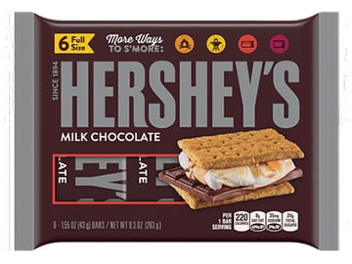

生产规划中的能力与需求平衡策略
生产计划体系
能力与需求平衡策略：
Chase Strategy
Level Strategy
案例来源：

Slide 4
Hershey’s use of chase strategy
生产计划体系
生产规划中的能力与需求平衡策略
Demand for chocolate is high during the winter months. Facilitated by the location of Hershey’s manufacturing facility, the company hires farmers from the surrounding areas to aid in meeting demand.
When demand drops in the spring and summer months the farmers are let go and thus able to return the their fields.

Slide 5
生产计划体系
生产规划中的能力与需求平衡策略
Densepack：
Forecast demands over the next six months for a particular line of disk drives produced in the Milpitas, California, plant are 1280, 640, 900, 1200, 2000 and 1400. There are currently (Dec) 300 workers employed in the Milpitas plant. Ending inventory in December is expected to be 500 units, and the firm would like to have 600 units on hand at the end of June.

Slide 6
生产规划中的能力与需求平衡策略
生产计划体系
Define the net predicted demand for January as 780 and the net predicted demand for June as 2000. By ending inventory are both zero.
Month | Net predicted demand | Net cumulative demand
Jan | 780 | 780
Feb | 640 | 1420
Mar | 900 | 2320
Apr | 1200 | 3520
May | 2000 | 5520
Jun | 2000 | 7520

Slide 7
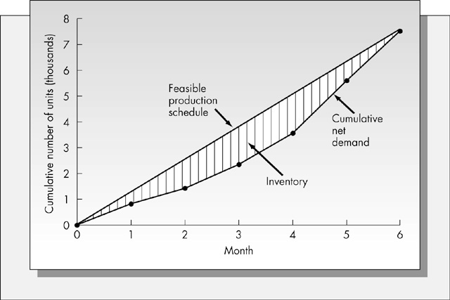
生产规划中的能力与需求平衡策略
生产计划体系

Slide 8
生产规划中的能力与需求平衡策略
生产计划体系
Define
= Cost of hiring one worker = $500
= Cost of firing one worker = $1000
= Cost of holding one unit of inventory for one month = $80
K = Number of aggregate units produced by one worker in one day

Slide 9
生产规划中的能力与需求平衡策略
生产计划体系
The plant manager observed that over 22 working days, with the workforce level constant at 76 workers, the firm produced 245 disk drives. That means that on average the production rate was 245/22=11.1364 drives per day.
It follows that one worker produced an average of 11.1364/76=0.14653 drive in one day. K = 0.14653 for this example.

Slide 10
Chase Strategy (Zero Inventory Plan)
生产计划体系
生产规划中的能力与需求平衡策略
Change the workforce each month in order to produce enough units to most closely match the demand pattern to minimize the levels of inventory the firm must hold during the planning horizon

Slide 11
生产计划体系
生产规划中的能力与需求平衡策略
A | B | C | D | E
Month | Number of working days | No. of Units produced per worker (B*0.14653) | Forecast net demand | Minimum No. of workers required (D/C rounded up)
January | 20 | 2.931 | 780 | 267
February | 24 | 3.517 | 640 | 182
March | 18 | 2.638 | 900 | 342
April | 26 | 3.810 | 1,200 | 315
May | 22 | 3.224 | 2,000 | 621
June | 15 | 2.198 | 2,000 | 910

Slide 12
生产计划体系
生产规划中的能力与需求平衡策略
A | B | C | D | E | F | G | H | I
Month | No. of workers | No. hired | No. fired | No. of units per worker | No. of units produced | Cumulative production | Cumulative demand | Ending inventory
Jan | 267 |  |  | 2.931 |  |  | 780
Feb | 182 |  |  | 3.517 |  |  | 1420
Mar | 342 |  |  | 2.638 |  |  | 2320
Apr | 315 |  |  | 3.810 |  |  | 3520
May | 621 |  |  | 3.224 |  |  | 5520
Jun | 910 |  |  | 2.198 |  |  | 7520
Total
Total cost of this plan =

Slide 13
生产计划体系
生产规划中的能力与需求平衡策略
A | B | C | D | E | F | G | H | I
Month | No. of workers | No. hired | No. fired | No. of units per worker | No. of units produced | Cumulative production | Cumulative demand | Ending inventory
Jan | 267 |  | 33 | 2.931 | 783 | 783 | 780 | 3
Feb | 182 |  | 85 | 3.517 | 640 | 1423 | 1420 | 3
Mar | 342 | 160 |  | 2.638 | 902 | 2325 | 2320 | 5
Apr | 315 |  | 27 | 3.810 | 1200 | 3525 | 3520 | 5
May | 621 | 306 |  | 3.224 | 2002 | 5527 | 5520 | 7
Jun | 910 | 289 |  | 2.198 | 2000 | 7527 | 7520 | 7
Total |  | 755 | 145 |  |  |  |  | 30
Total cost of this plan = 755*500+145*1000+30*80+600*80
= $572900

Slide 14
Level strategy (Constant workforce plan)
生产计划体系
生产规划中的能力与需求平衡策略
The goal is to eliminate completely the need for hiring and firing during the planning horizon.
In order to guarantee that shortages do not occur in any period, it is necessary to compute the minimum workforce required for every month in the planning horizon

Slide 15
生产计划体系
生产规划中的能力与需求平衡策略
A | B | C | D
Month | Cumulative net demand | Cumulative No. of units produced per worker | Ratio B/C (rounded up)
January | 780 | 2.931 | 267
February | 1,420 | 6.448 | 221
March | 2,230 | 9.086 | 256
April | 3,520 | 12.896 | 273
May | 5,520 | 16.120 | 343
June | 7,520 | 18.318 | 411

Slide 16
生产计划体系
生产规划中的能力与需求平衡策略
A | B | C | D | E | F
Month | No. of units produced per worker | Monthly production | Cumulative production | Cumulative net demand | Ending inventory
Jan | 2.931 |  |  | 780
Feb | 3.517 |  |  | 1,420
Mar | 2.638 |  |  | 2,230
Apr | 3.810 |  |  | 3,520
May | 3.224 |  |  | 5,520
Jun | 2.198 |  |  | 7,520
Total
Total cost of this plan =

Slide 17
生产计划体系
生产规划中的能力与需求平衡策略
A | B | C | D | E | F
Month | No. of units produced per worker | Monthly production | Cumulative production | Cumulative net demand | Ending inventory
Jan | 2.931 | 1205 | 1205 | 780 | 425
Feb | 3.517 | 1445 | 2650 | 1,420 | 1230
Mar | 2.638 | 1084 | 3734 | 2,230 | 1414
Apr | 3.810 | 1566 | 5300 | 3,520 | 1780
May | 3.224 | 1325 | 6625 | 5,520 | 1105
Jun | 2.198 | 903 | 7528 | 7,520 | 8
Total |  |  |  |  | 5962
Total cost of this plan = (5962+600)*80+111*500 = $580460

Slide 18
生产规划中的能力与需求平衡策略
生产计划体系
Chase Approach
Advantages
Investment in inventory is low
Labor utilization in high
Disadvantages
The cost of adjusting output rates and/or workforce levels
Level Approach
Advantages
Stable output rates and workforce
Disadvantages
Greater inventory costs
Increased overtime and idle time
Resource utilizations vary over time

Slide 19
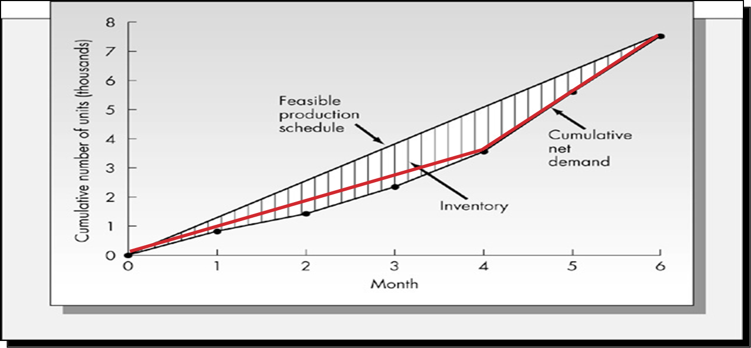
Mixed strategy
生产计划体系
生产规划中的能力与需求平衡策略
The zero inventory plan and constant workforce strategies treated above are pure strategies: they are designed to achieve one objective.
With more flexibility, small modifications can result in dramatically lower costs.

